Slide 1
In Search of Reference Points for WCNPO Striped Marlin
Jon Brodziak
NOAA Fisheries
Jon.Brodziak@NOAA.GOV
Presentation 4-April-2022 (JST)

Slide 2
Roadmap for Striped Marlin Reference Point Search
Background
Problem Statement
Nonstationary Ocean Environment
Analytical Methods
Mean Generation Time Based on Life History Parameterers
Time Series of Population & Environmental Time Series
Change Point Analyses of Time Series
Conclusions

Slide 3
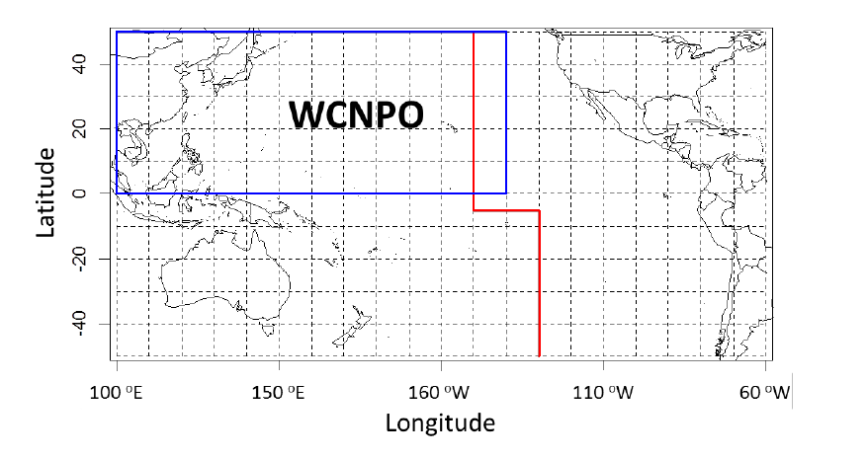
WCNPO Striped Marlin Management Unit for 2022 Benchmark Assessment
Black rectangle is management unit for 2022 assessment, blue rectangle is 2015 management unit, red line is RFMO boundary

Slide 4
2021 Striped Marlin Stock-Recruitment Dynamics

Slide 5
2021 Striped Marlin Spawning Biomass

Slide 6
Revised 2021 Striped Marlin Fishing Mortality

Slide 7
2021 Striped Marlin Recruitment Time Series

Slide 8
What Regulates Fishery Productivity of WCNPO Striped Marlin ? Maternal Effects or Environmental Forcing ? Or Both ?

Slide 9
What Time Period Best Represents the Prevailing Conditions for Determining Maximum Sustainable Yield for the WCNPO Striped Marlin Stock? “MSY is the largest long-term average catch or yield that can be taken from a stock or stock complex under prevailing ecological, environmental conditions and fishery technological characteristics (e.g., gear selectivity), and the distribution of catch among fleets.” USA National Standard 1 Guidelines (NMFS 2016)

Slide 10
Some Drivers of Nonstationary Ocean Environment

Slide 11
Nonstationary Ocean Environment
Increasing Global Ocean Heat Content

Slide 12
Nonstationary Ocean Environment
Increasing Marine Heat Waves

Slide 13
Increasing Temperature Impacts Egg Mass and Survival

Slide 14
Nonstationary Ocean Environment
Decreasing pH and Increasing pCO2

Slide 15
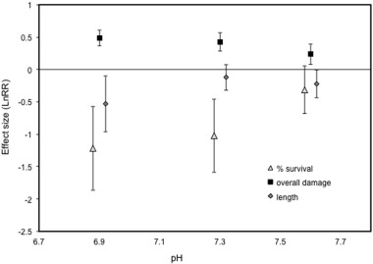
Decreasing pH Impacts on Yellowfin Tuna Larvae
Fig. 3. Effect size analysis (with 95% CI) of mean % survival, growth and summed damage
after 7 days of feeding comparing the control to 3 different pH treatment levels.

Slide 16
Nonstationary Ocean Environment
Decrease in Global Ocean O₂ Content

Slide 17
Nonstationary Ocean Environment
Increase in Global Mean Sea Level

Slide 18
Nonstationary Ocean Environment
Hindcast Temperature Impacts on MSY for Some Stocks

Slide 19
MSY Reference Point Analysis Options for Striped Marlin
Status Quo Analyses: Use MSY estimates from SS3 model outputs
Prevailing conditions occur throughout assessment time horizon
Fishery productivity is stationary
Time-Varying Analyses: Use MSY proxy estimates from time window corresponding to prevailing conditions
Also known as “Dynamic B0 reference point analyses”
Prevailing conditions occur through some subset of assessment time horizon
Fishery productivity is approximately stationary under prevailing conditions
If MSY Analyses Are Time-Varying, Then What Time Period Do We Use ?

Slide 20
Status Quo Analyses: 2021 Biological Reference Points
Reference Point | Estimate
F_{MSY} (age 3-12) | 0.61
F₂₀₁₇ (age 3-12) | 0.88
F_{20%SB(F=0)} | 0.47
SB_{MSY} | 2,534 mt
SB₂₀₁₇ | 849 mt
SB_{20%(F=0)} | 3,493 mt
MSY | 4,820 mt
C₂₀₁₅₋₂₀₁₇ | 2,076 mt
SPR_{MSY} | 18%
SPR₂₀₁₇ | 13%
SPR_{20%SB(F=0)} | 23%

Slide 21
What Is the Mean Generation Time for Striped Marlin ?
Mean generation time is the average interval between the birth of an individual and the birth of its offspring
Mean generation time depends on life history parameters and survival rate
Calculate MGT based on age-structured population formulation similar to Caswell (2001) and implemented in YPR module in NOAA Fisheries Toolbox available at: https://nmfs-fish-tools.github.io/YPR/

Slide 22
Striped Marlin: Alternative Life History Scenarios

Slide 23
Mean Generation Time by Life History Scenario
WCNPO MGT_{F=0} = 4.8 yr
Mean generation time (MGT) calculations using NOAA Fisheries Toolbox YPR module: https://nmfs-fish-tools.github.io/YPR/

Slide 24
Mean Generation Time Results
Unfished mean generation times for Striped Marlin life history scenarios are:
WCNPO MGT = 4.8 years
SWPO MGT = 4.8 years
EPO MGT = 9.6 years
2019 WCNPO MGT = 5.2 years
WCNPO, SWPO and 2019 WCNPO mean generation times are similar over the range of fishing mortalities examined, or F in [0, 2]
EPO mean generation time is about 2-fold higher than MGTs for other Striped Marlin life history scenarios
Implication for MSY Time Window: Use an integer multiple of MGT to account for full set of cohorts per generation in an unfished population

Slide 25
MLS Population and Environmental Time Series Analyses
Empirical Correlation Analyses – Are there obvious associations ?
Autocorrelation Function Analyses – Are time series serially correlated ?
Partial Autocorrelation Function Analyses – Are time series observations correlated after adjustment for dependence on intermediate values ?
Cross-correlation Function Analyses – Are pairs of time series serially correlated ?
Nonstationarity - If ACF decays slowly and PACF has large absolute value at lag-1 then conclude series is nonstationary and has changing mean or changing variance or both.

Slide 26
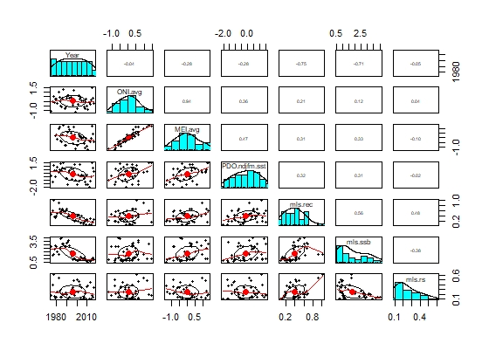
Empirical Correlations Among Time Series
Year ONI MEI PDO REC SSB R/SSB
Year
ONI
MEI
PDO
REC
SSB
R/SSB

Slide 27
Important Rank Correlations
(Year, Recruitment) with ρ = -0.75
(Year, Spawning Biomass) with ρ = -0.71
(Recruitment, Spawning Biomass) with ρ = 0.56
(Recruitment, Recruits Per Spawner) with ρ = 0.48
(ONI, MEI) with ρ = 0.94
(MEI, PDO) with ρ = 0.47

Slide 28
Autocorrelation Function Results
Recruitment: Positive ACF at Lags 1:8 with range 0.36 to 0.60
Spawning Biomass: Positive ACF at Lags 1:7 with range 0.41 to 0.88
Recruits Per Spawner: none
ONI: Negative ACF at Lag 2 with ρ₂ = -0.32
MEI: none
PDO: Positive ACF at Lag 1 with ρ₁ = 0.34

Slide 29
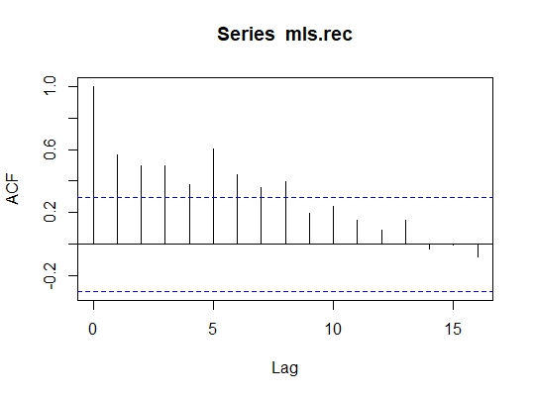
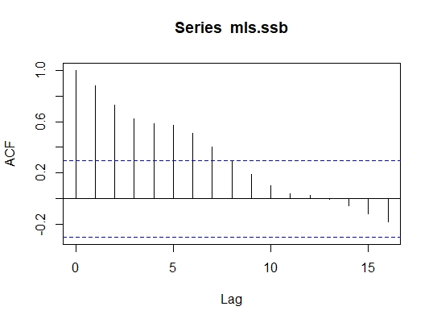
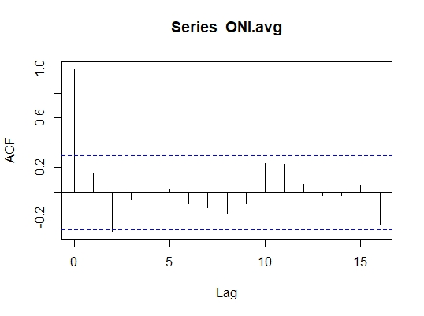
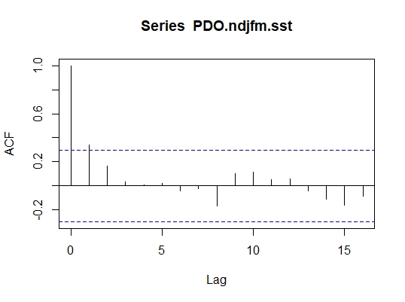

Slide 30
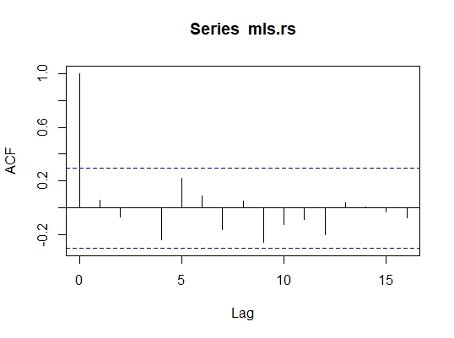
Autocorrelation Function: Recruits Per Spawner

Slide 31
Partial Autocorrelation Function Results
Recruitment: Positive PACF at Lags 1 and 5 with α₁ = 0.56 & α₅ = 0.46
Spawning Biomass: Positive PACF at Lag 1 with α₁ = 0.89
Recruits Per Spawner: none
ONI: Negative PACF at Lag 2 with α₂ = -0.36
MEI: Negative PACF at Lag 2 with α₂ = -0.32
PDO: Positive PACF at Lag 1 with α₁ = 0.34

Slide 32
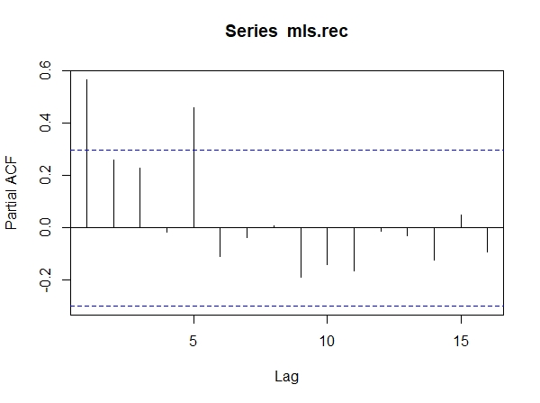
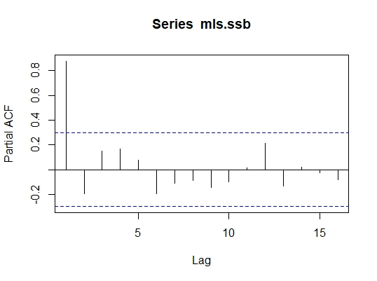
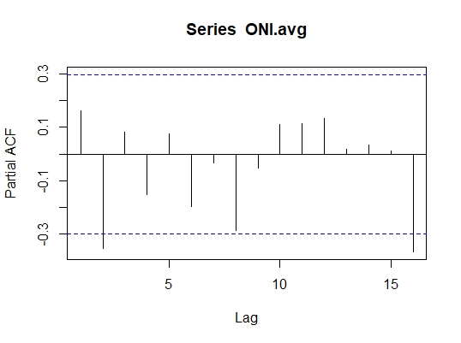
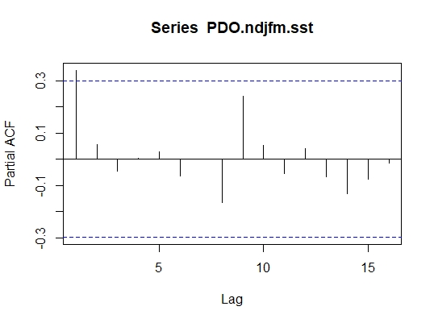

Slide 33
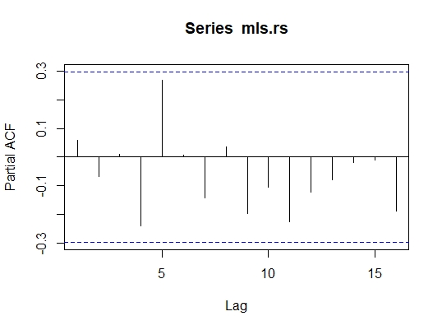
Partial Autocorrelation Function: Recruits Per Spawner

Slide 34
Summarize Time Series Results
Recruitment: Nonstationary with probable AR(1) or MA(1+) processes
Spawning Biomass: Nonstationary with probable AR(1) or MA(1+) processes
Recruits Per Spawner: none
ONI: Nonstationary with probable negative serial correlation at lag 2
MEI: Same as ONI but shorter time series
PDO: Nonstationary with probable AR(1) or MA(1) processes

Slide 35
Cross Correlation Function Results: Recruitment
Recruitment*Spawning Biomass: CCF at lags -9:7 with R_{XY} range of (0.33,0.77)
Recruitment*Recruits Per Spawner: CCF at lag 0 with R_{XY} = 0.48
Recruitment*ONI: none
Recruitment*MEI: CCF at lags -1 and 3 with R_{XY} = 0.33 and 0.37
Recruitment*PDO: CCF at lags -1:0 and 2:5 with R_{XY} range of (0.32,0.39)

Slide 36
CCF Results: Spawning Biomass
Spawning Biomass*Recruits Per Spawner: CCF at lag 0 with R_{XY} = -0.38
Spawning Biomass*ONI: none
Spawning Biomass*MEI: CCF at lags -2 and 0:1 with R_{XY} range of (0.32,0.33)
Spawning Biomass*PDO: CCF at lags -2, 0:1 and 3:7 with R_{XY} range of (0.31,0.39)

Slide 37
CCF Results: Recruits Per Spawner
Recruits Per Spawner*ONI: none
Recruits Per Spawner*MEI: none
Recruits Per Spawner*PDO: none

Slide 38
CCF Results: Environmental Forcing Indices
ONI*MEI: CCF at lags -1:0 with R_{XY} range of (0.33,0.94)
ONI*PDO: CCF at lags -1:0 with R_{XY} range of (0.36,0.58)
MEI*PDO: CCF at lags -1:0 with R_{XY} range of (0.47,0.64)

Slide 39
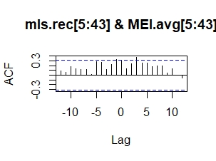
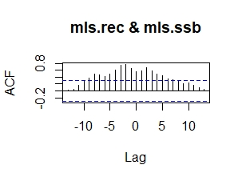
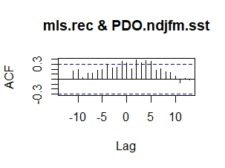
Summarize CCF Results

Slide 40
Summarize Cross Correlation Function Results
Recruitment and Spawning Biomass show positive serial correlation, as expected
Recruitment shows some positive serial correlation with ENSO and PDO
Recruits Per Spawner lacks strong serial correlation with other series
ENSO has lag (+1) positive correlation with PDO

Slide 41

Changepoint Detection
for Ecosystem Processes
Jon Brodziak
NOAA Fisheries
Pacific Islands Fisheries Science Center Jon.Brodziak@NOAA.GOV
American Fisheries Society Annual Meeting Abstract
Portland, Oregon, USA, August 16-20, 2015
Notes:
Here we are one-sixth of the way into the 21st century, fisheries science is focusing less on resource extraction and more on maintaining marine ecosystems. This will require an interdisciplinary and adaptive approach because ecosystem processes can change abruptly through time, via regime shifts, and also noting that data streams of observations can also exhibit rapid change with information technology improvements.

Slide 42
Background: Fisheries Management
If regime shifts in marine fish stock-recruitment processes can be expected, then how do we calculate MSY-based reference points to account for this ?
How can we detect regimes ?
What do we do about them ?

Slide 43
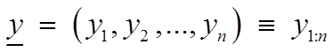
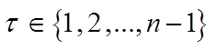
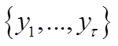
Changepoint Detection Models
Estimating the point where the statistical properties of a sequence of observations change
Applications include: climatology, bioinformatics, finance, oceanography, medical imaging
Single changepoint detection for y
A changepoint exist when there exists a time
such that the statistical properties
of and differ

Slide 44
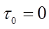
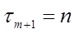
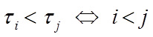
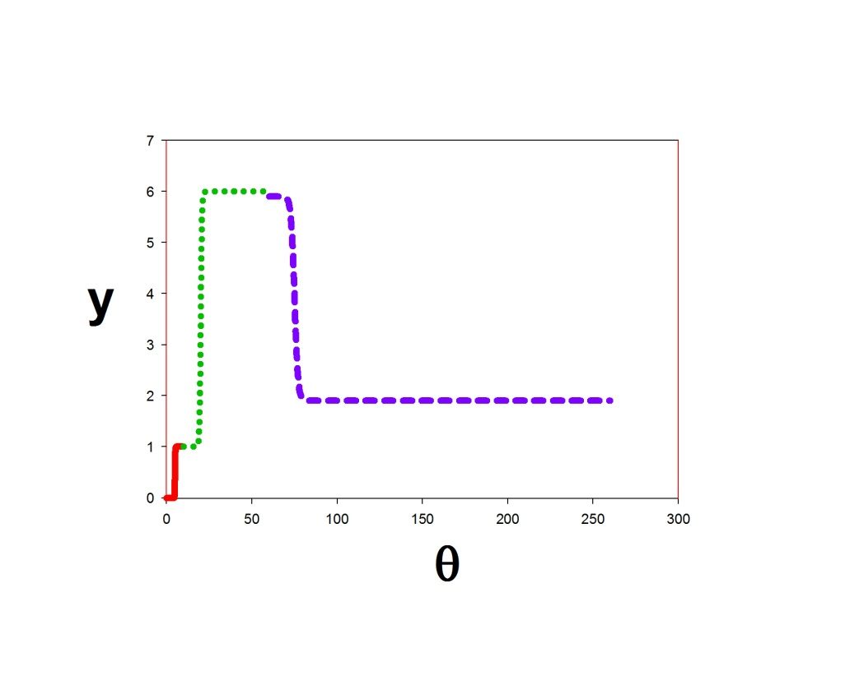
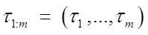
Changepoint Detection Models
Multiple changepoint detection with m changepoints
Changepoint starting and ending positions are
Changepoints are ordered
Changepoint positions are

Slide 45
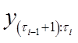
Changepoint Detection Models
The m changepoints split the observations into m+1 segments and the ith segment is
Parameters associated with the ith segment are
Where θ_{i} are the quantities of interest that may contain changes along with any nuisance parameters
If m is unknown, number of changepoint sets is

Slide 46
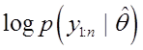
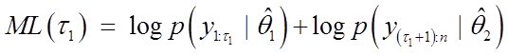
Changepoint Detection Models
Single changepoint detection test
Null hypothesis is there is no changepoint (m=0)
Maximum loglikelihood under null hypothesis is
Alternative hypothesis is there is a changepoint (m=1) with maximum loglikelihood under alternative hypothesis for a given

Slide 47
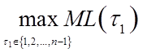
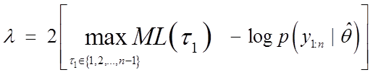
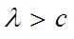
Changepoint Detection Models
And the maximum loglikelihood under the alternative hypothesis is
The likelihood ratio test statistic is
Reject H₀ if
Various approaches exist for choosing c including information criteria and p-values

Slide 48
Changepoint Detection Models
Multiple changepoint detection test
Minimize a cost function C() across segments with a penalty function f () for over fitting the number of changepoints
Three minimization algorithms are implemented in the R package changepoint (Killick and Eckley 2013)
BinSeg, or Binary Segmentation (Edwards et al. 1965. Biometrics) – speed is O(n*log(n))
Segment Neighborhoods (Auger et al. 1989. Bull. Math. Biol.) – speed is O(Q*n²)
PELT, or Pruned Exact Linear Time (Killick et al. 2012. JASA) – speed is O(n)

Slide 49
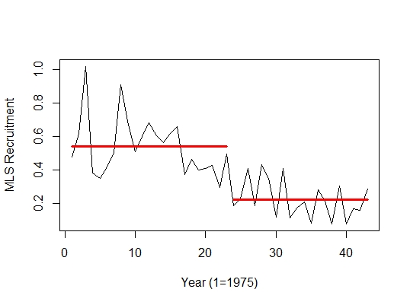
Change Point Results: Recruitment using PELT & BinSeg
PELT
BinSeg
1997
1997

Slide 50
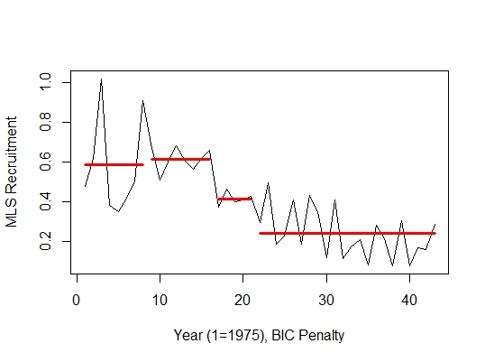
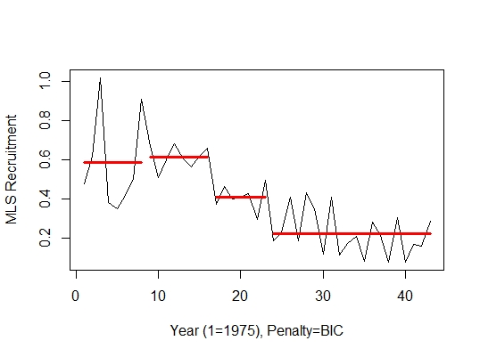
Change Point Results: Recruitment using PELT & BinSeg With BIC Penalty
PELT
BinSeg
1995
1997

Slide 51
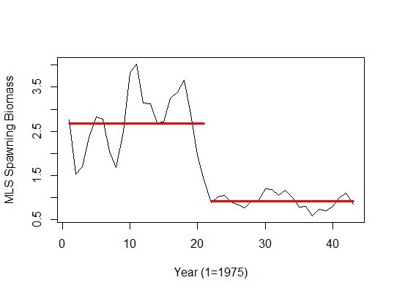
Change Point: Spawning Biomass using PELT & BinSeg
PELT
BinSeg
1995
1995

Slide 52
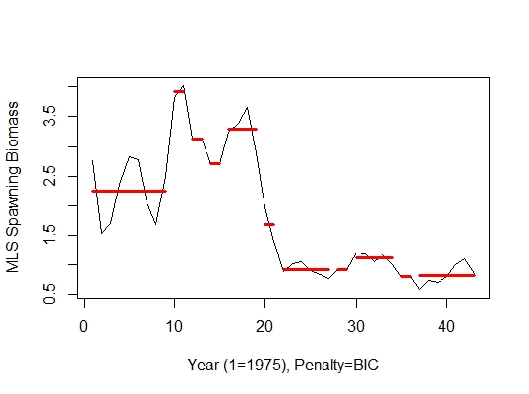
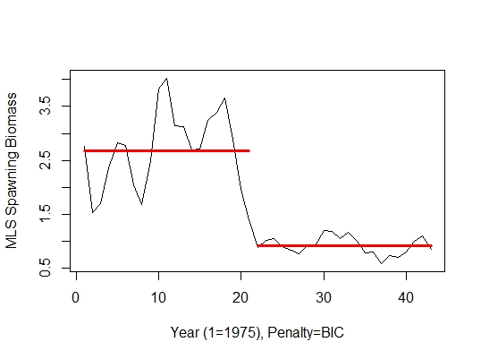
Change Point: Spawning Biomass using PELT & BinSeg With BIC Penalty
PELT
BinSeg

Slide 53
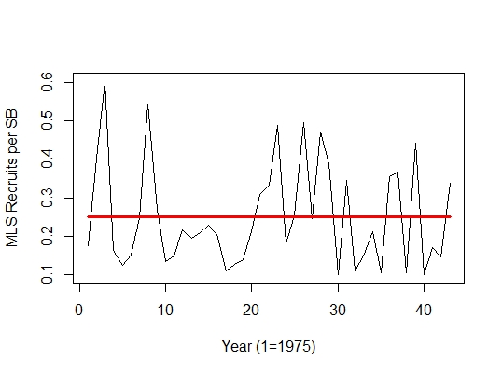
Change Point: Recruits Per Spawner using PELT & BinSeg
PELT
BinSeg
none
none

Slide 54
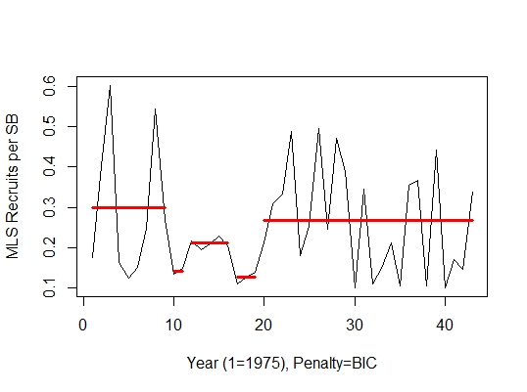
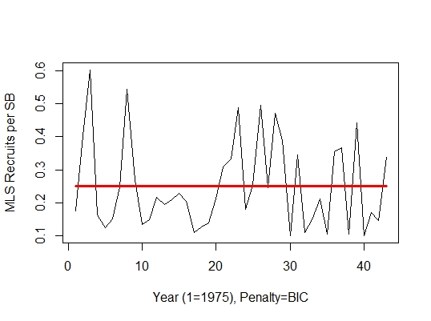
Change Point: Recruits Per Spawner using PELT & BinSeg With BIC Penalty
PELT
BinSeg
none
1993

Slide 55
Some Empirical Results for Setting Time Window for Striped Marlin Under Prevailing Conditions
Recruits Per Spawner (or Survival Ratio) Series for Striped Marlin appears to be approximately stationary over the assessment time horizon
Recruitment and Spawning Biomass Series for Striped Marlin are nonstationary with a substantial decreasing trend over (1975, 2017).
Mean generation times of WCNPO and SWPO life histories are about 5 years and integer multiples are 0, 5, 10, 15, 20, 25 years, and so on.
Some short-term environmental forcing may be notable for Recruitment

Slide 56
Example of “Dynamic B0” Calculation for Striped Marlin from 2021 Assessment
Reference Point | Estimate
F_{MSY} (age 3-12) | 0.61
F₂₀₁₇ (age 3-12) | 0.88
F_{20%SB(F=0)} | 0.47
SB_{MSY} | 2,534 mt
SB₂₀₁₇ | 849 mt
SB_{20%(F=0)} | 3,493 mt
MSY | 4,820 mt
C₂₀₁₅₋₂₀₁₇ | 2,076 mt
SPR_{MSY} | 18%
SPR₂₀₁₇ | 13%
SPR_{20%SB(F=0)} | 23%

Slide 57

~ Thanks and Mahalo !
Notes:
Thanks and Mahalo!

